Slide 1
Preparation for Exam
Practice Exam 1, 2, and 3
Tutor: Dr. Farshid Keivanian

Slide 2
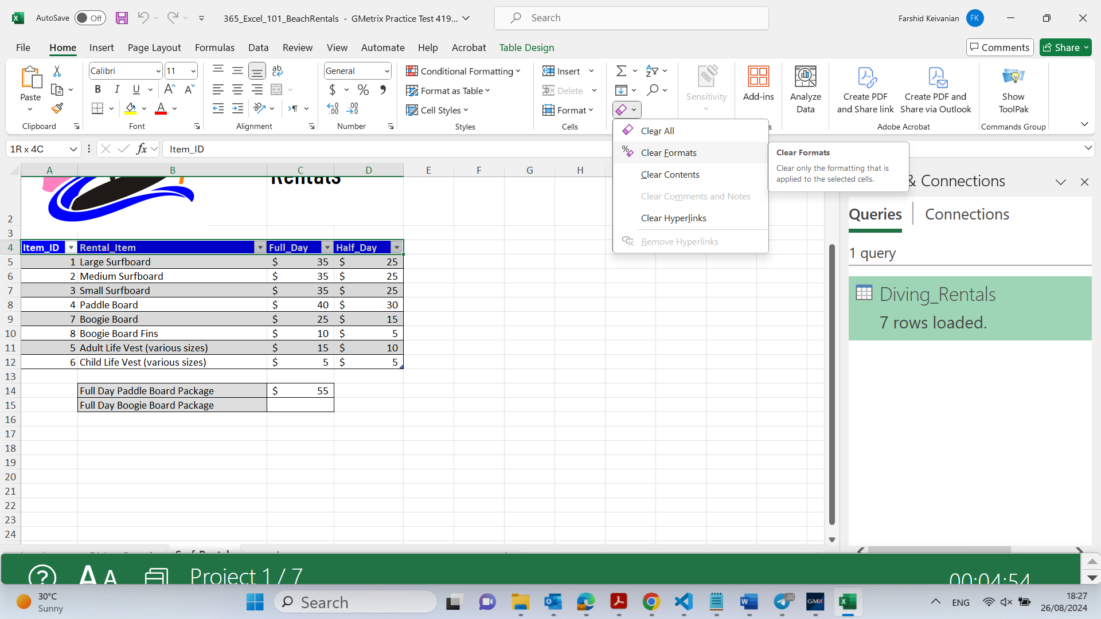
On the Surf_Rentals worksheet, clear the formatting in cell range A4:D4

Slide 3
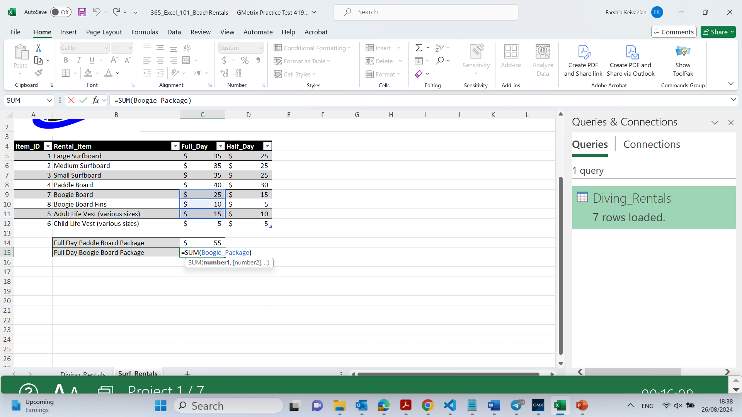
On the Surf_Rentals worksheet In cell C15, enter the rental cost of a Full Day Boogie Board Package using the SUM function and the named range Boogie_Package.

Slide 4
On the Surf_Rentals worksheet In cell C15, enter the rental cost of a Full Day Boogie Board Package using the SUM function and the named range Boogie_Package.

Slide 5
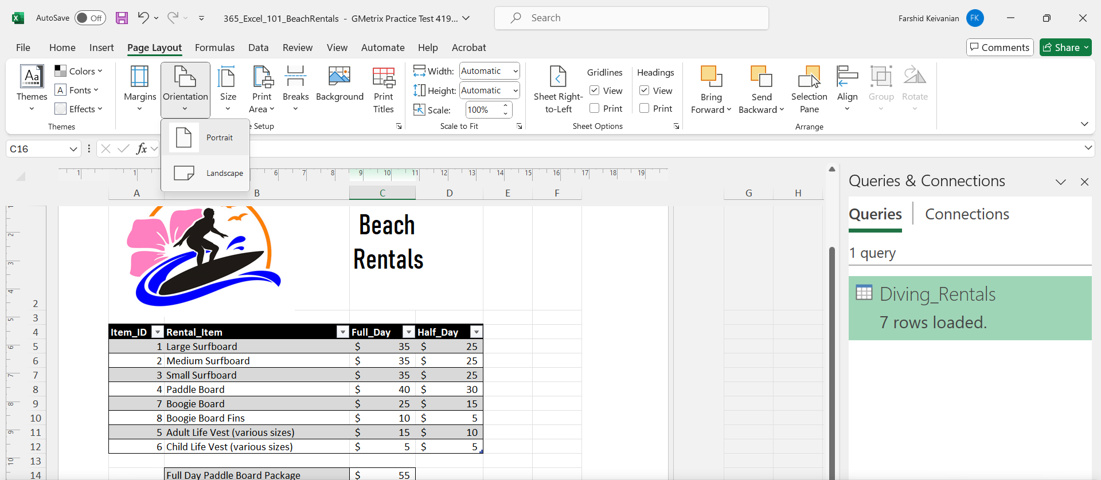
Change the orientation of the Surf_Rentals worksheet to Landscape.

Slide 6
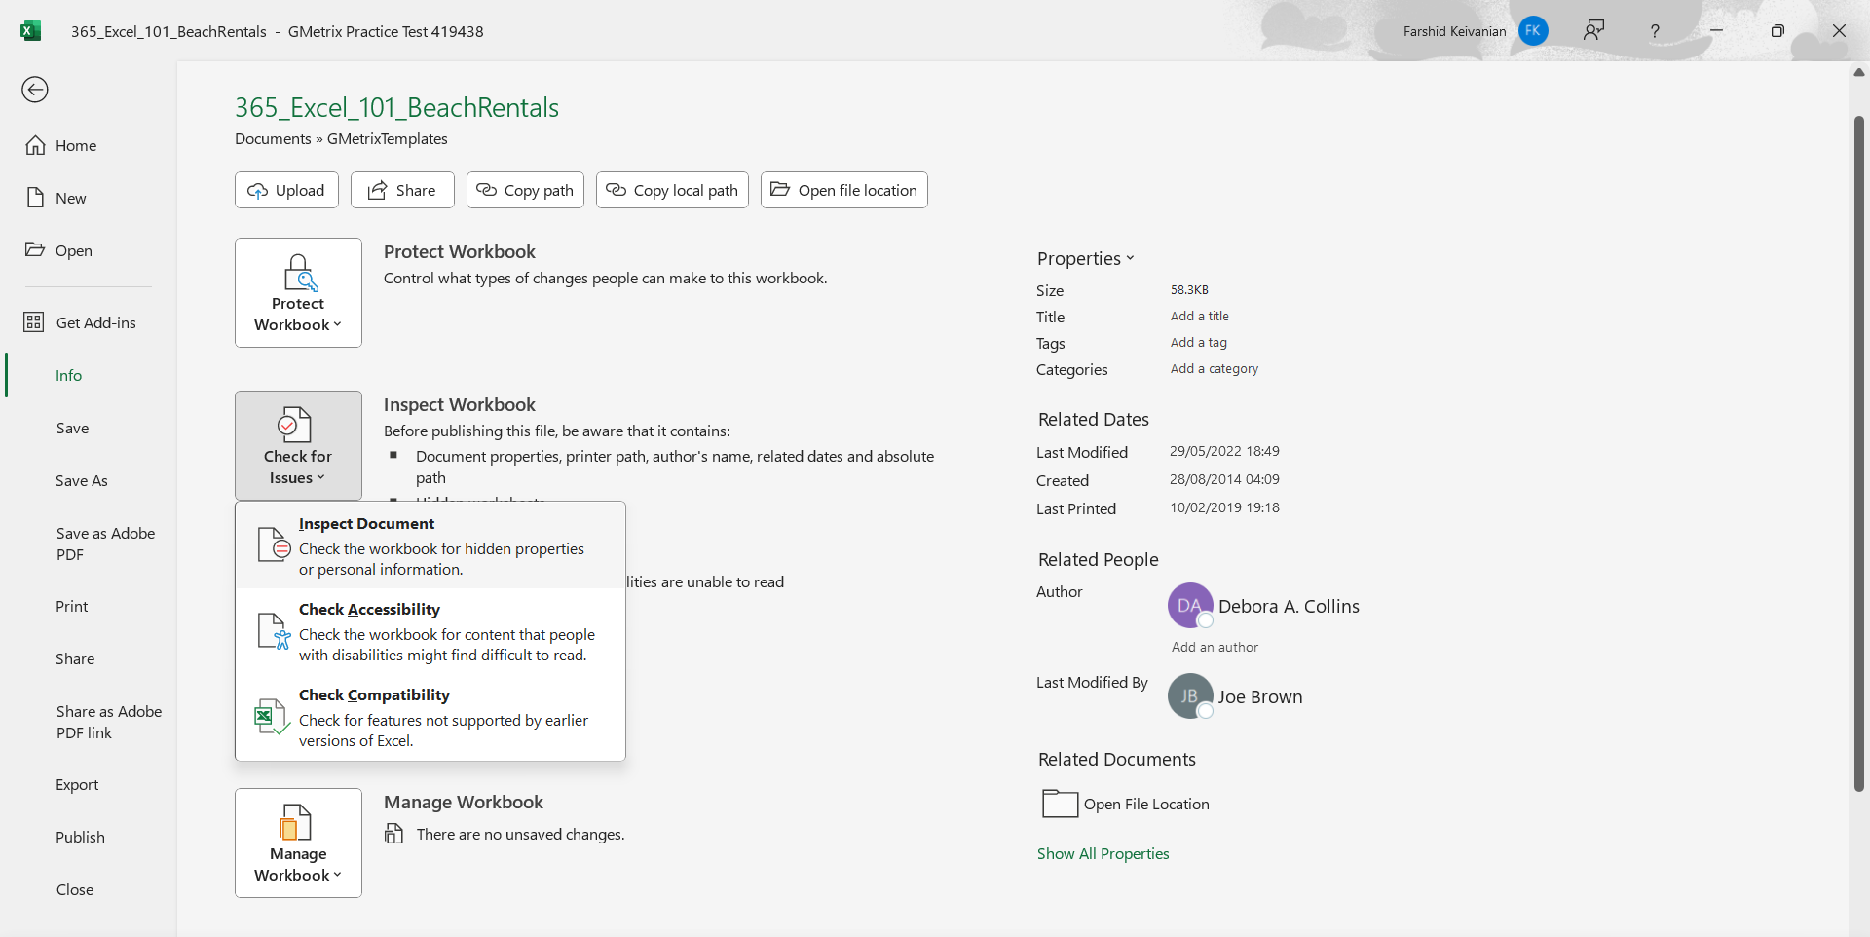
Inspect the workbook for compatibility issues. Copy the results to a new worksheet.

Slide 7
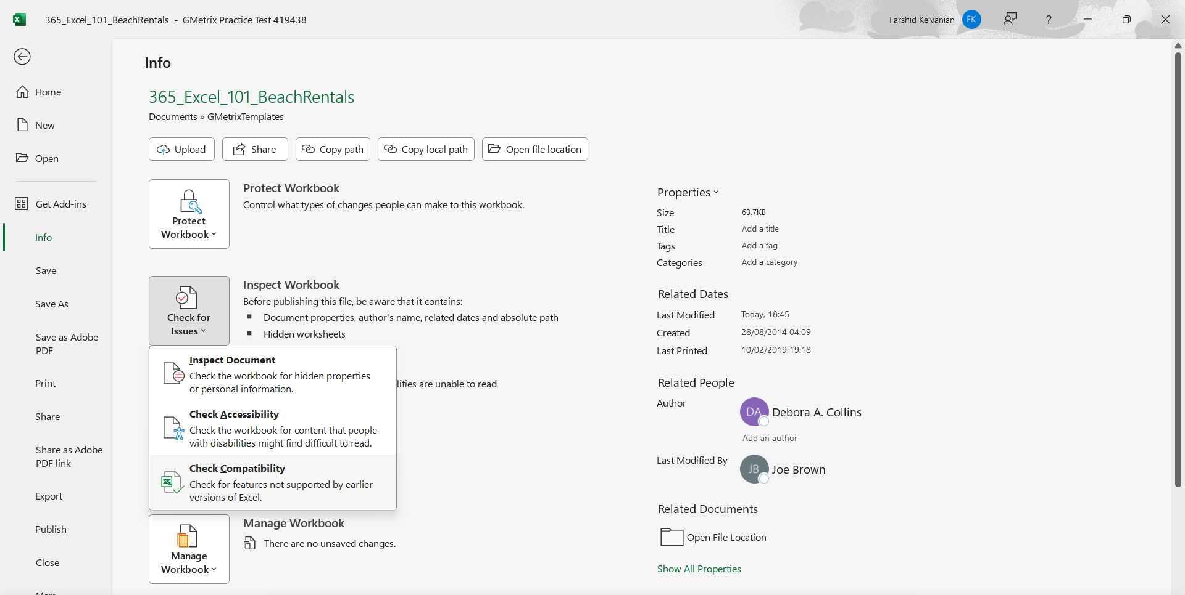
Inspect the workbook for compatibility issues. Copy the results to a new worksheet.

Slide 8
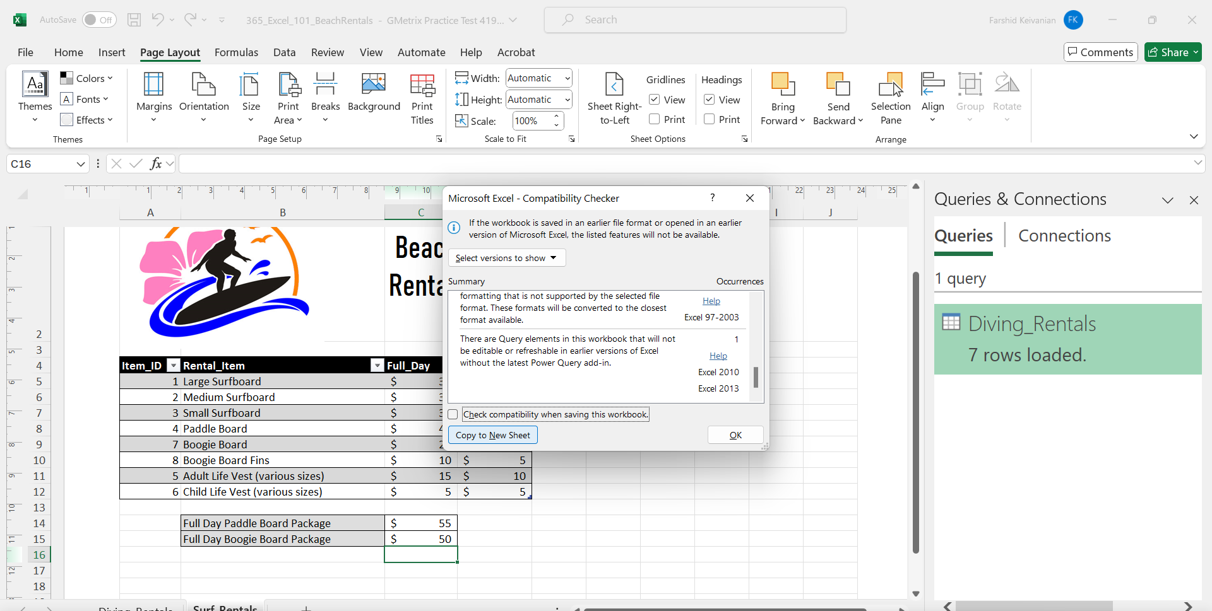
Inspect the workbook for compatibility issues. Copy the results to a new worksheet.

Slide 9
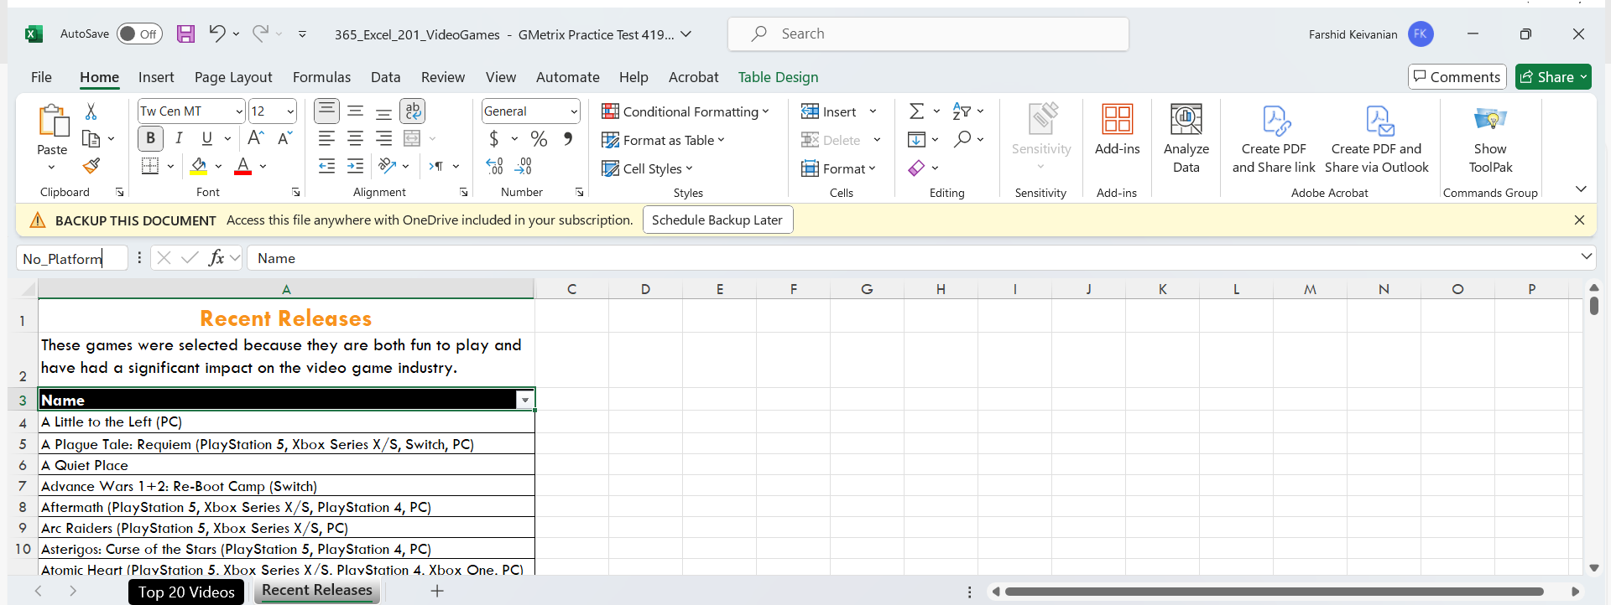
Practice Exam 2: On the Recent Releases worksheet, select all of the video game titles in the cell range named No_Platform and delete their rows. Retain all other cells on the worksheet.
To delete all rows containing video game titles in the cell range named No_Platform while retaining all other cells on the Recent Releases worksheet, follow these steps:

Slide 10
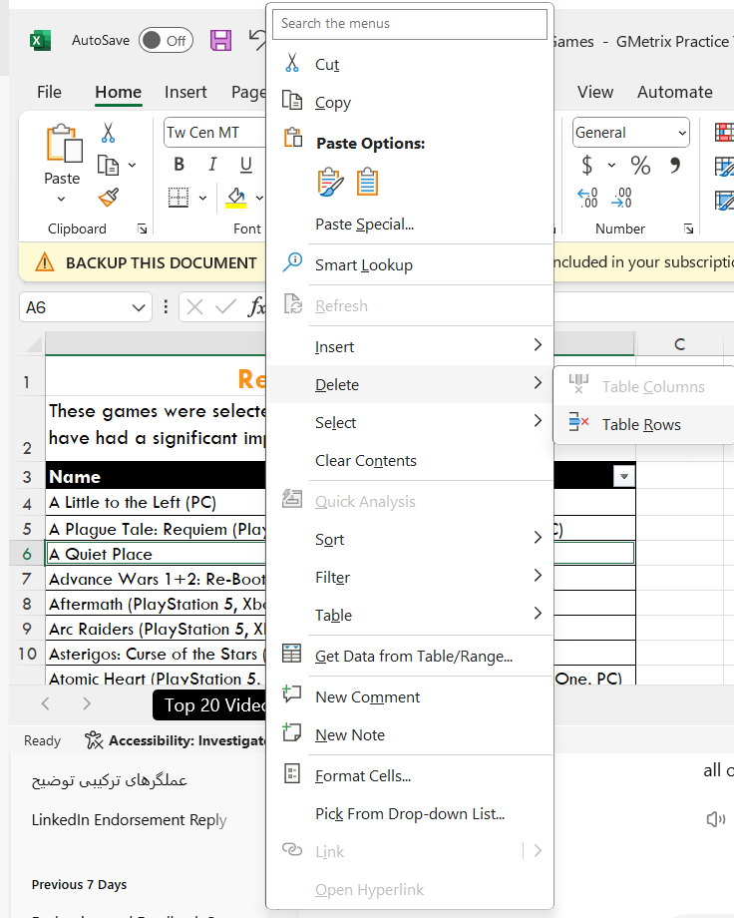
Practice Exam 2: On the Recent Releases worksheet, select all of the video game titles in the cell range named No_Platform and delete their rows. Retain all other cells on the worksheet.
Right-click on one of the selected cells.
Delete
This will delete the rows containing the video game titles in the No_Platform range, while retaining all other cells on the worksheet.

Slide 11
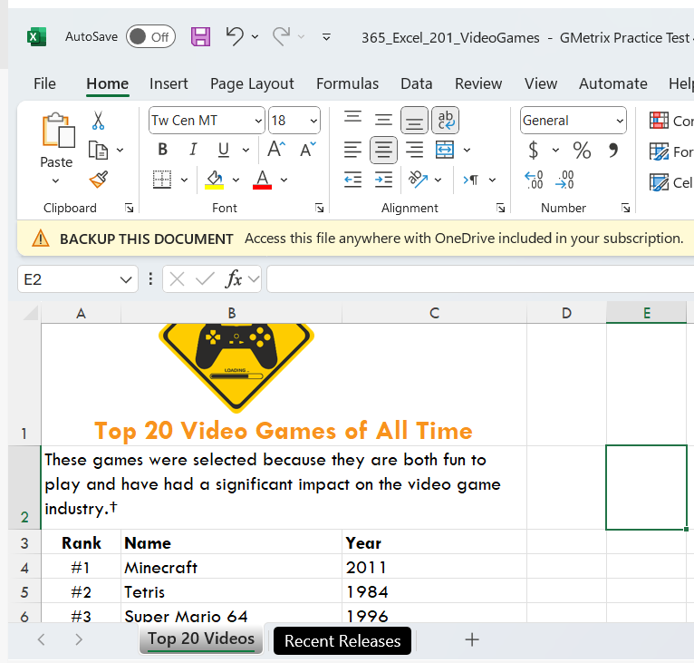
On the Top 20 Videos worksheet, change the width of column C to 9
Right-click on one of the selected cells.
Delete
This will delete the rows containing the video game titles in the No_Platform range, while retaining all other cells on the worksheet.

Slide 12
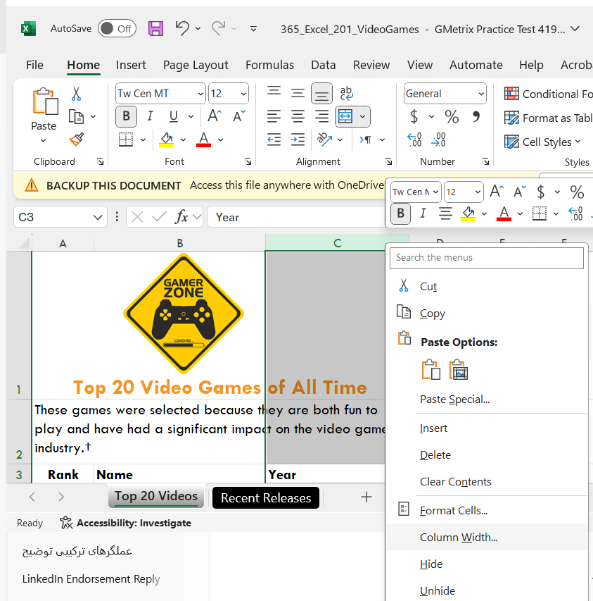
On the Top 20 Videos worksheet, change the width of column C to 9
Click on C to Select it
Right Click on C
Column Width
Column Width = 9

Slide 13
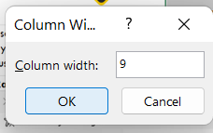
On the Top 20 Videos worksheet, change the width of column C to 9
Click on C to Select it
Right Click on C
Column Width
Column Width = 9

Slide 14
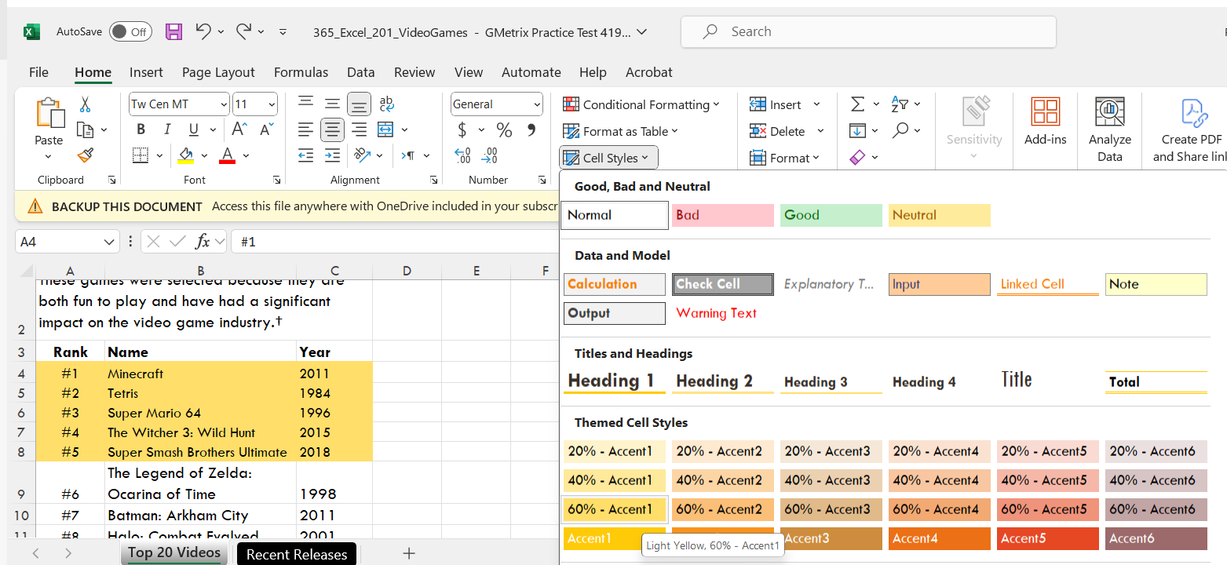
On the Top 20 Videos worksheet, apply the cell style 60% - Accent 1 to the top 5 video games located in cell range A4:C8..
Select Cell Range
Home >> Cell Styles >> 60% - Accent 1

Slide 15
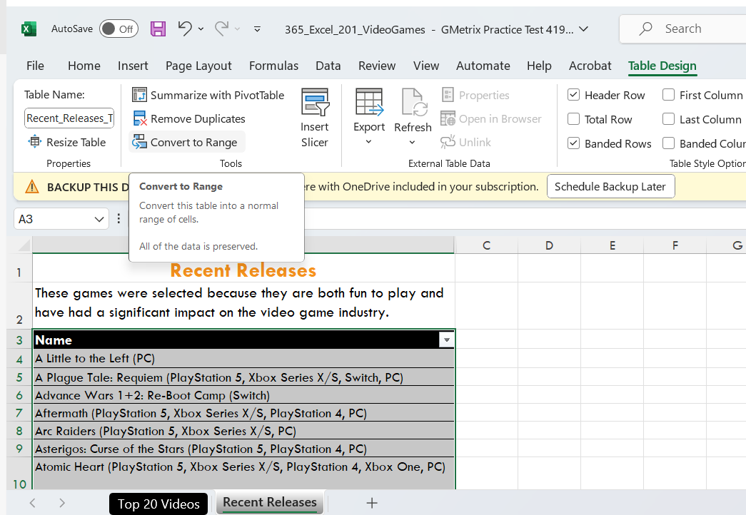
Convert the table on the Recent Releases worksheet to a cell range.
Click only on Table
Click on Table Design
Convert to Range

Slide 16
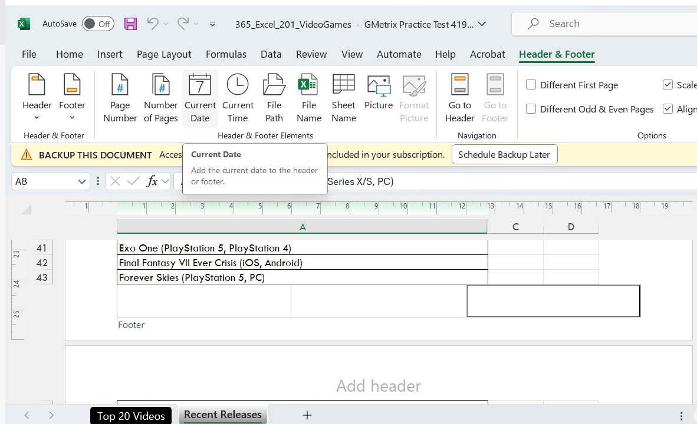
Insert a Footer that displays today's date on the right and then return to Normal view.
Click on View
Click on Page Layout
Scroll Down Right Side
Footer
Header & Footer >> Current Date

Slide 17
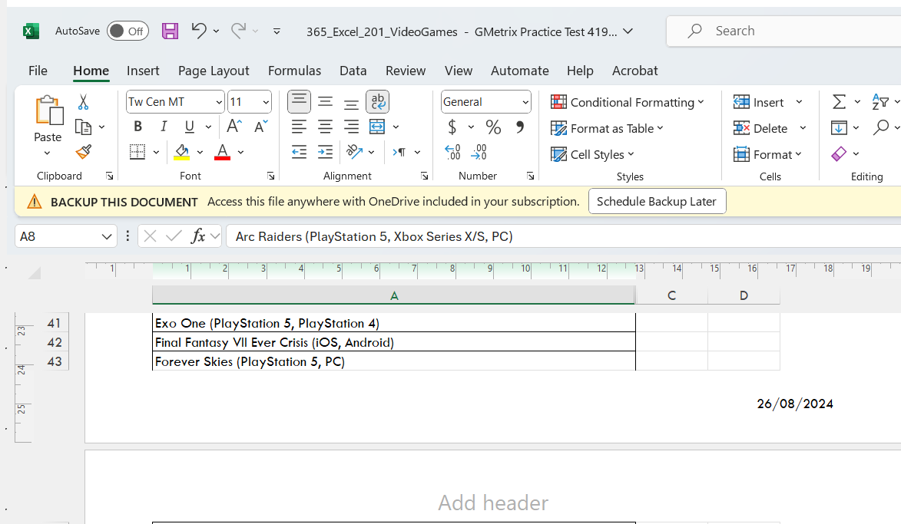
Insert a Footer that displays today's date on the right and then return to Normal view.
Click on View
Click on Page Layout
Scroll Down Right Side
Footer
Header & Footer >> Current Date

Slide 18
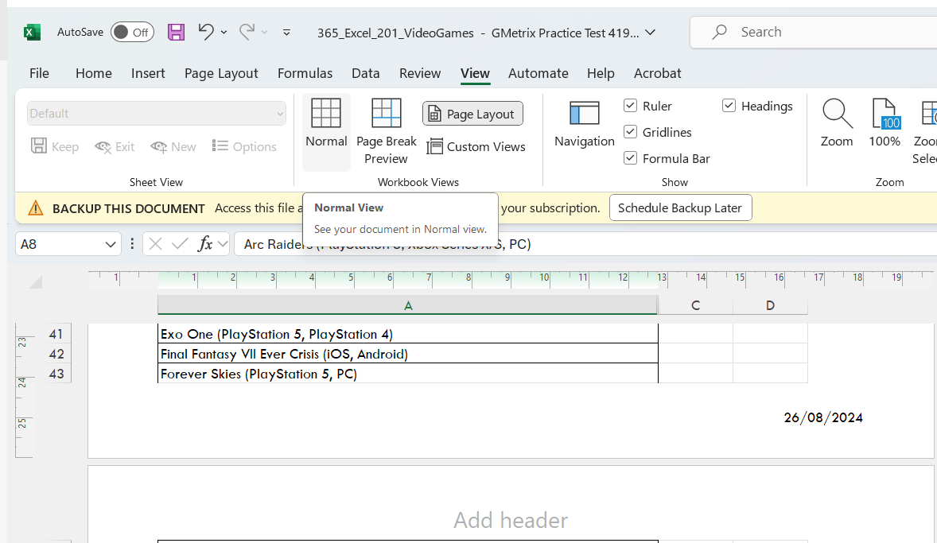
Insert a Footer that displays today's date on the right and then return to Normal view.
Return to Normal Worksheet View

Slide 19
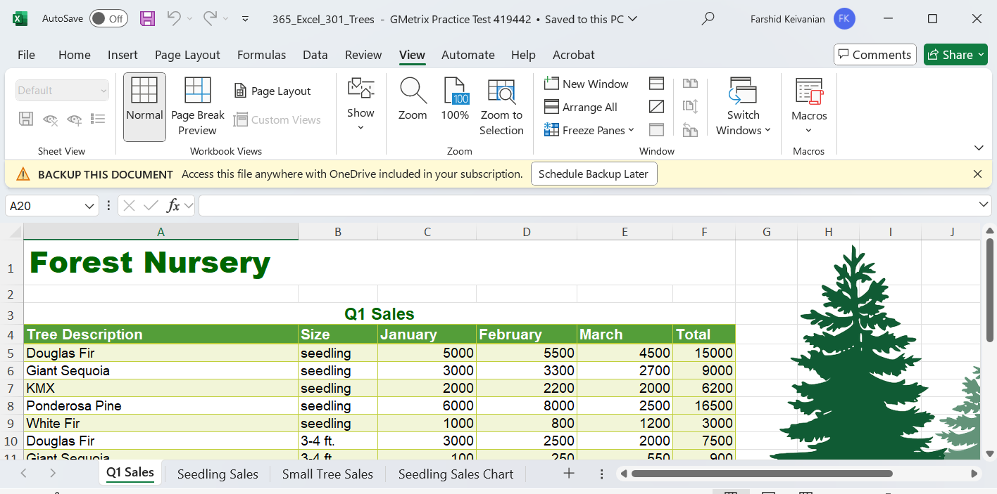
Practice Exam 3: On the Seedling Sales Chart worksheet, apply Style 5 to the chart.
Click on the chart in the Seedling Sales Chart worksheet to select it.

Slide 20
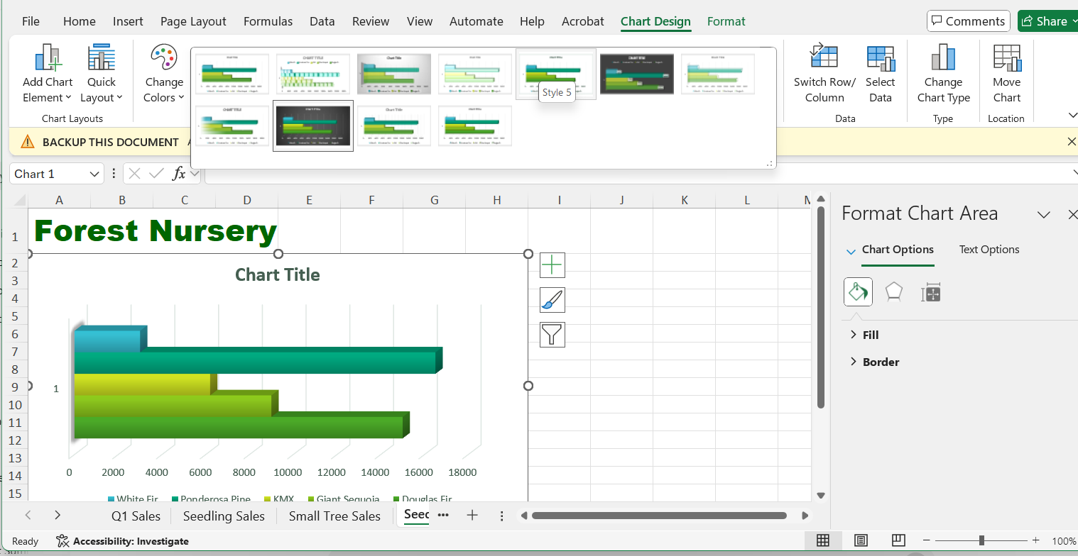
Practice Exam 3: On the Seedling Sales Chart worksheet, apply Style 5 to the chart.

Slide 21
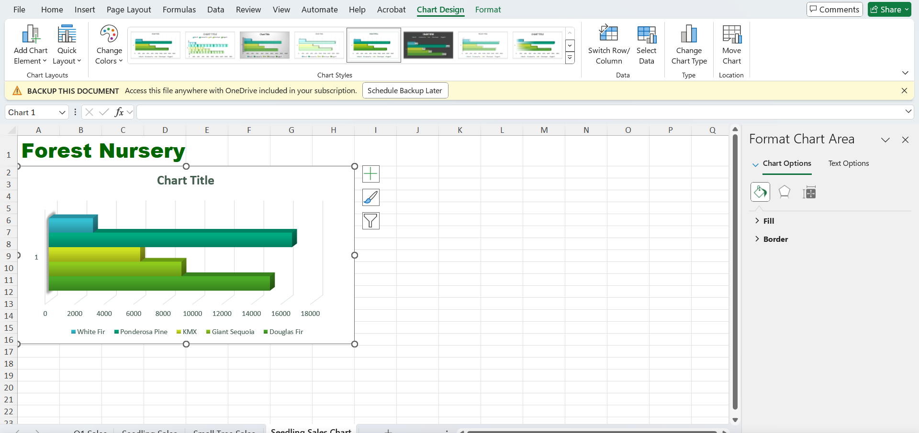
Switch the rows and column source data of the chart on the Seedling Sales Chart worksheet, so the Legend is displayed as Horizontal Axis Labels.

Slide 22
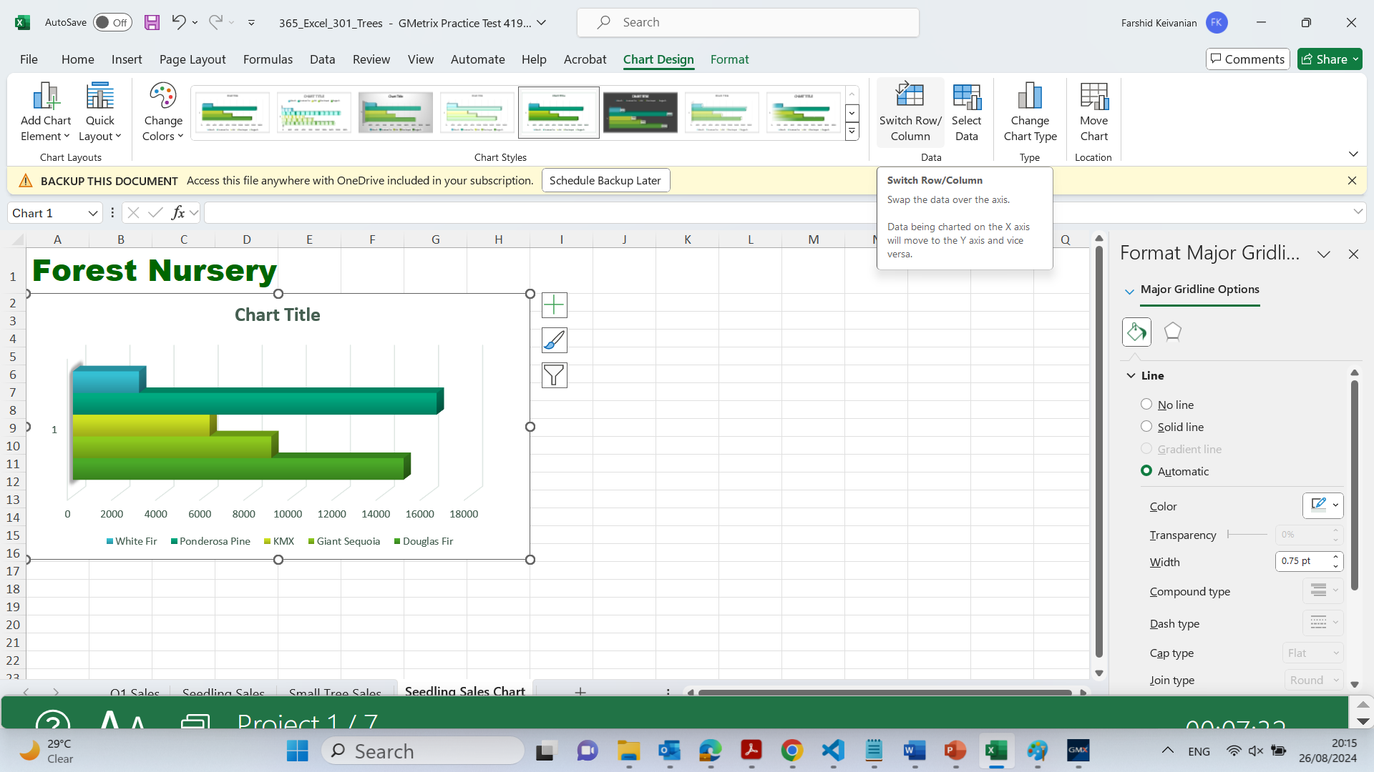
Switch the rows and column source data of the chart on the Seedling Sales Chart worksheet, so the Legend is displayed as Horizontal Axis Labels.

Slide 23
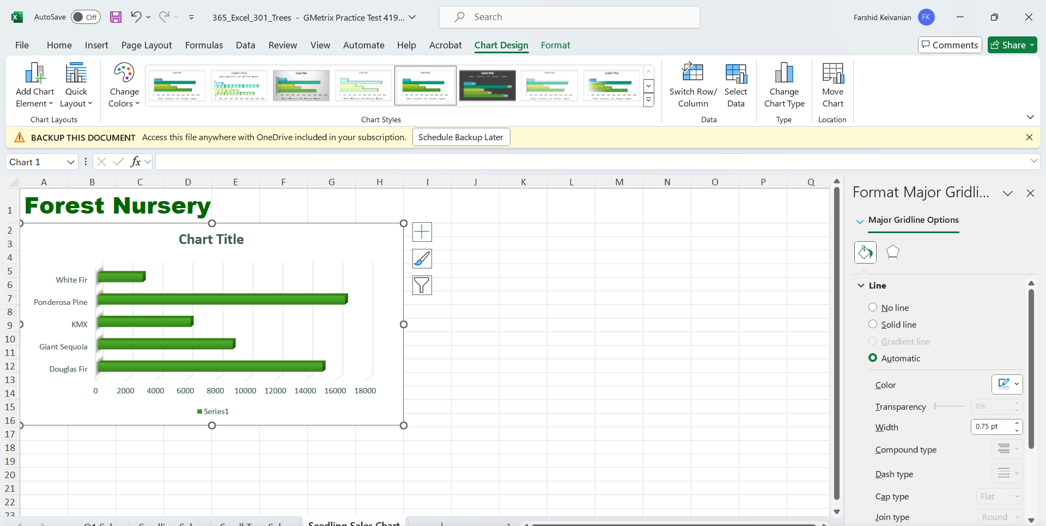
Switch the rows and column source data of the chart on the Seedling Sales Chart worksheet, so the Legend is displayed as Horizontal Axis Labels.

Slide 24
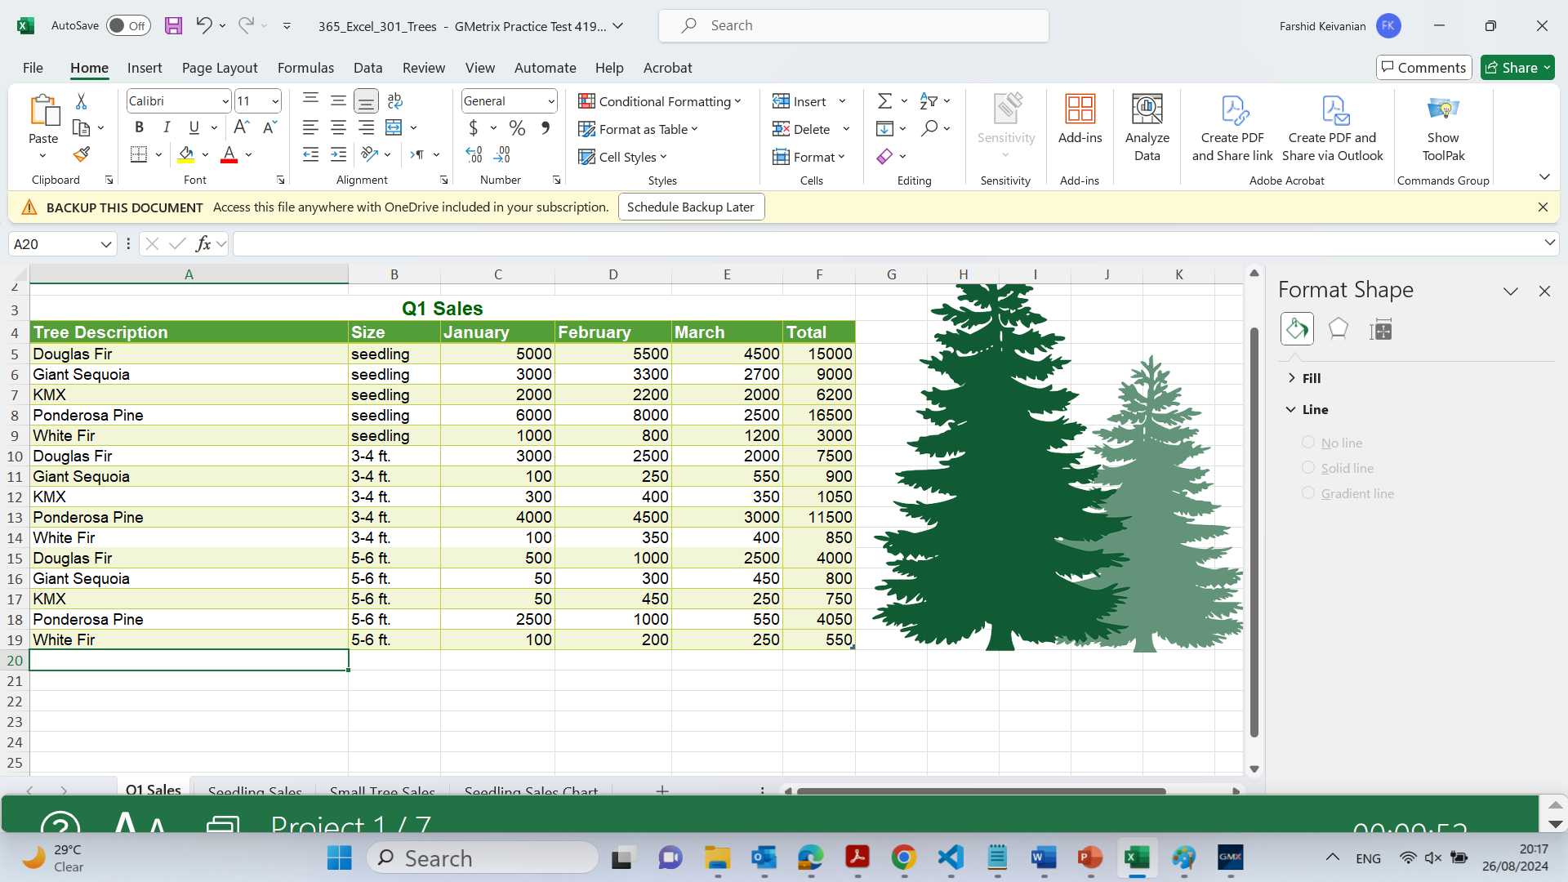
Insert Page 1 of ? page numbering in the header of the Q1 Sales worksheet. When finished, return to Normal view.

Slide 25
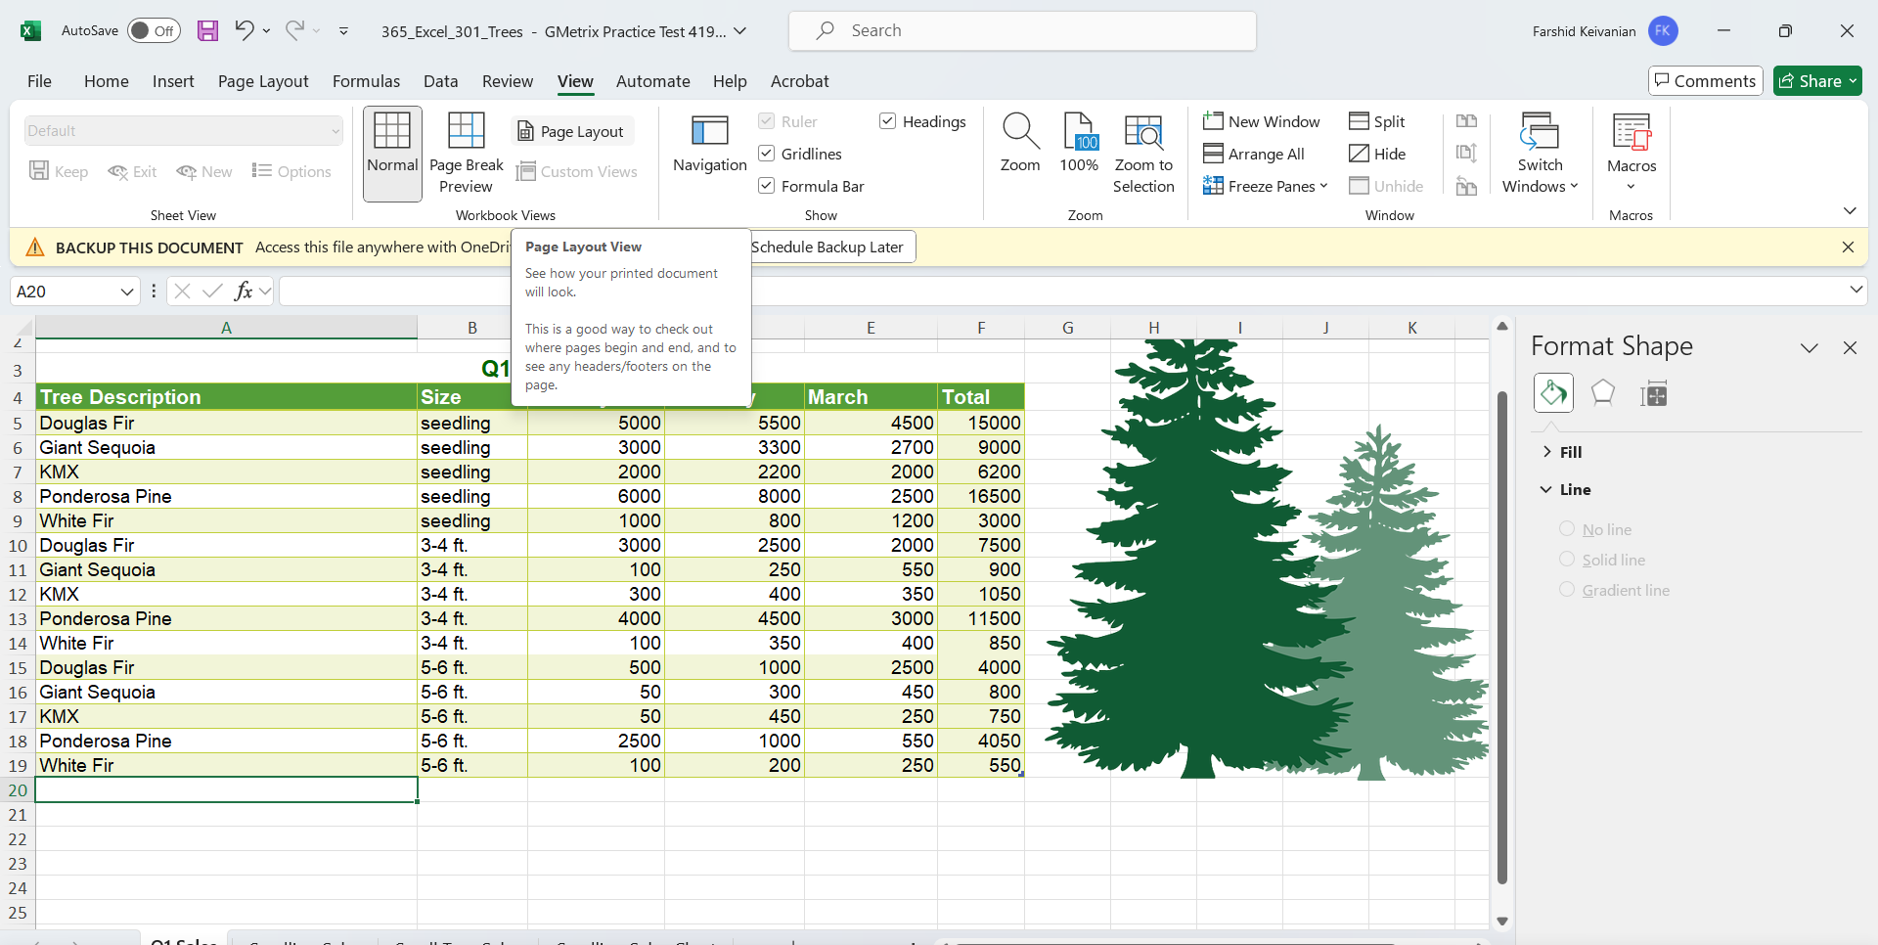
Insert Page 1 of ? page numbering in the header of the Q1 Sales worksheet. When finished, return to Normal view.

Slide 26
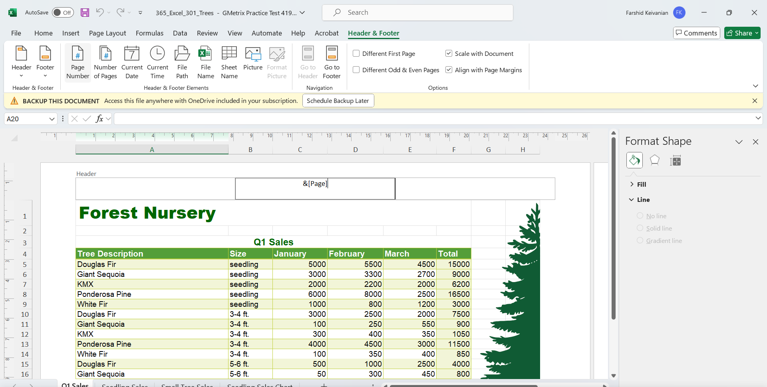
Insert Page 1 of ? page numbering in the header of the Q1 Sales worksheet. When finished, return to Normal view.

Slide 27
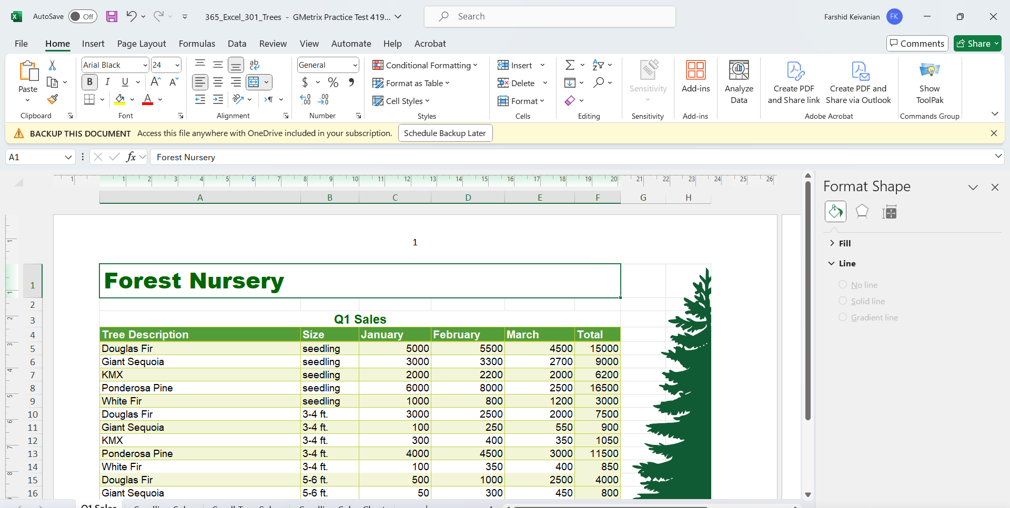
Insert Page 1 of ? page numbering in the header of the Q1 Sales worksheet. When finished, return to Normal view.

Slide 28
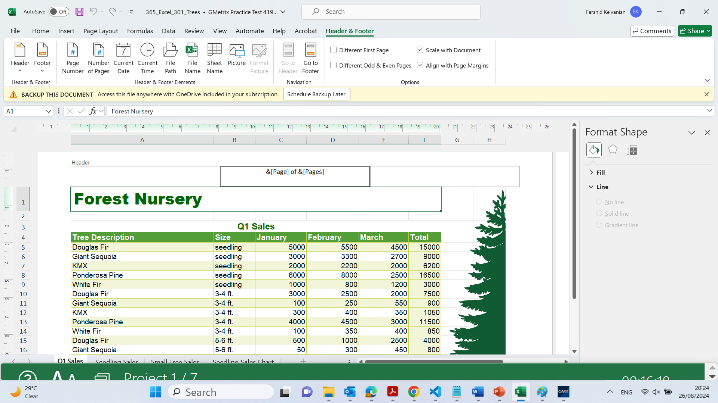
Insert Page 1 of ? page numbering in the header of the Q1 Sales worksheet. When finished, return to Normal view.

Slide 29

Insert Page 1 of ? page numbering in the header of the Q1 Sales worksheet. When finished, return to Normal view.

Slide 30
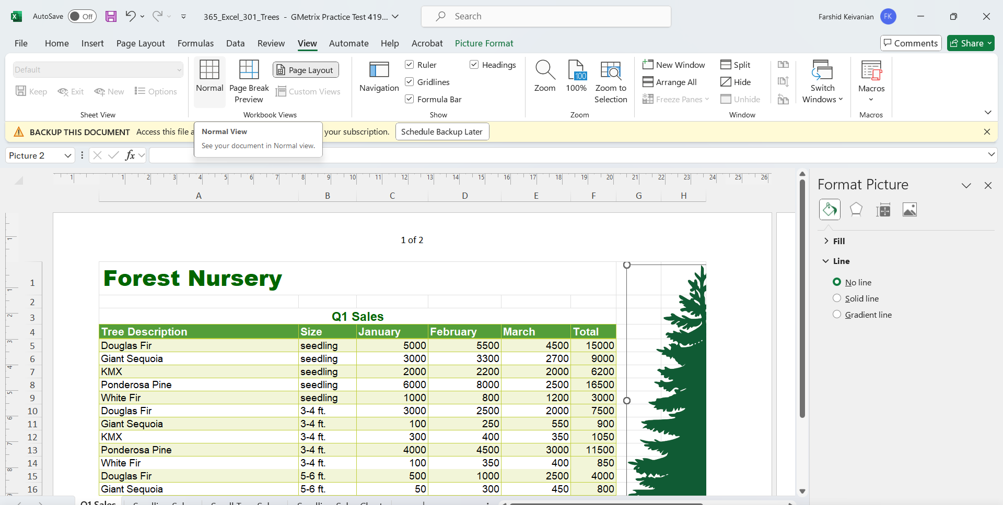
Insert Page 1 of ? page numbering in the header of the Q1 Sales worksheet. When finished, return to Normal view.

Slide 31
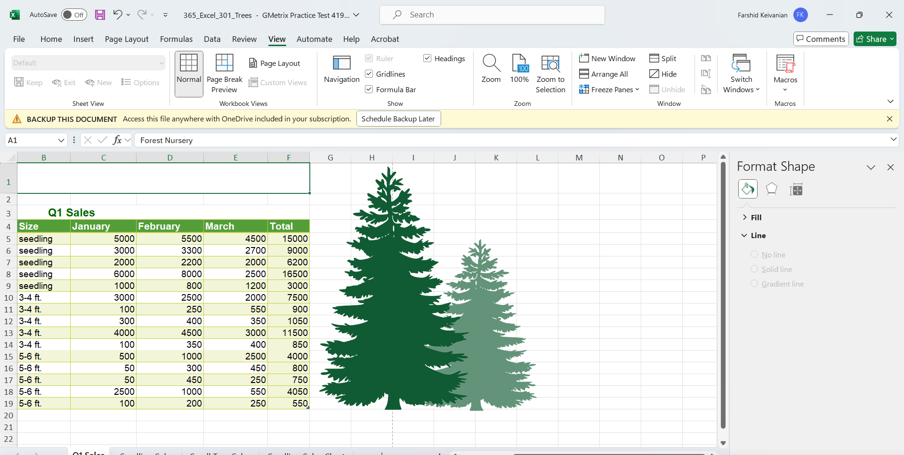
Copy the data from cell range A4:E9 on the Q1 Sales worksheet and transpose it to the cell range beginning at A4 on the Seedling Sales worksheet.

Slide 32
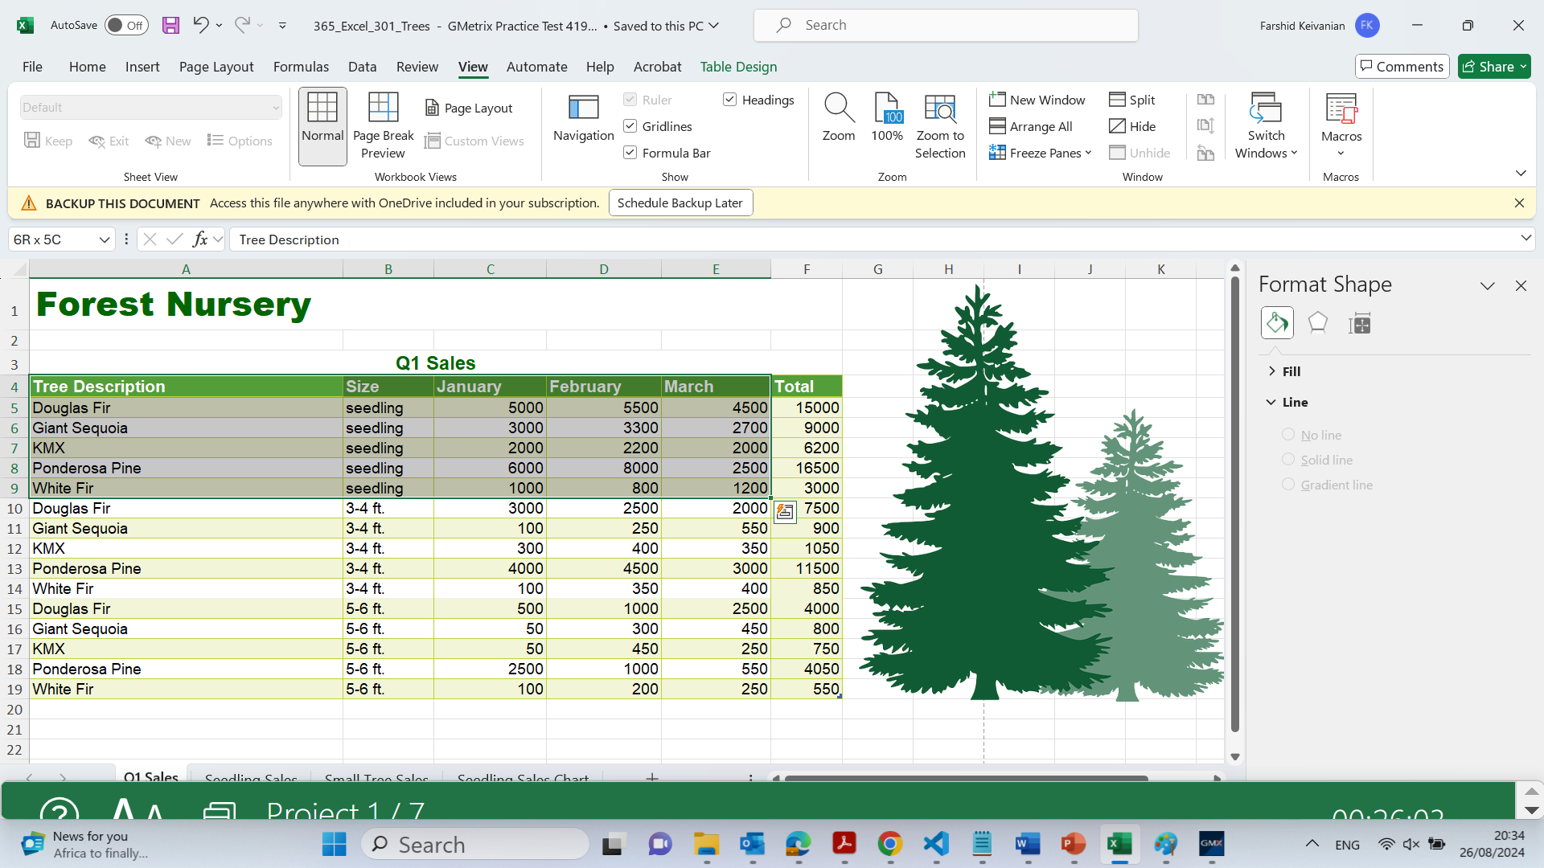
Copy the data from cell range A4:E9 on the Q1 Sales worksheet and transpose it to the cell range beginning at A4 on the Seedling Sales worksheet.

Slide 33
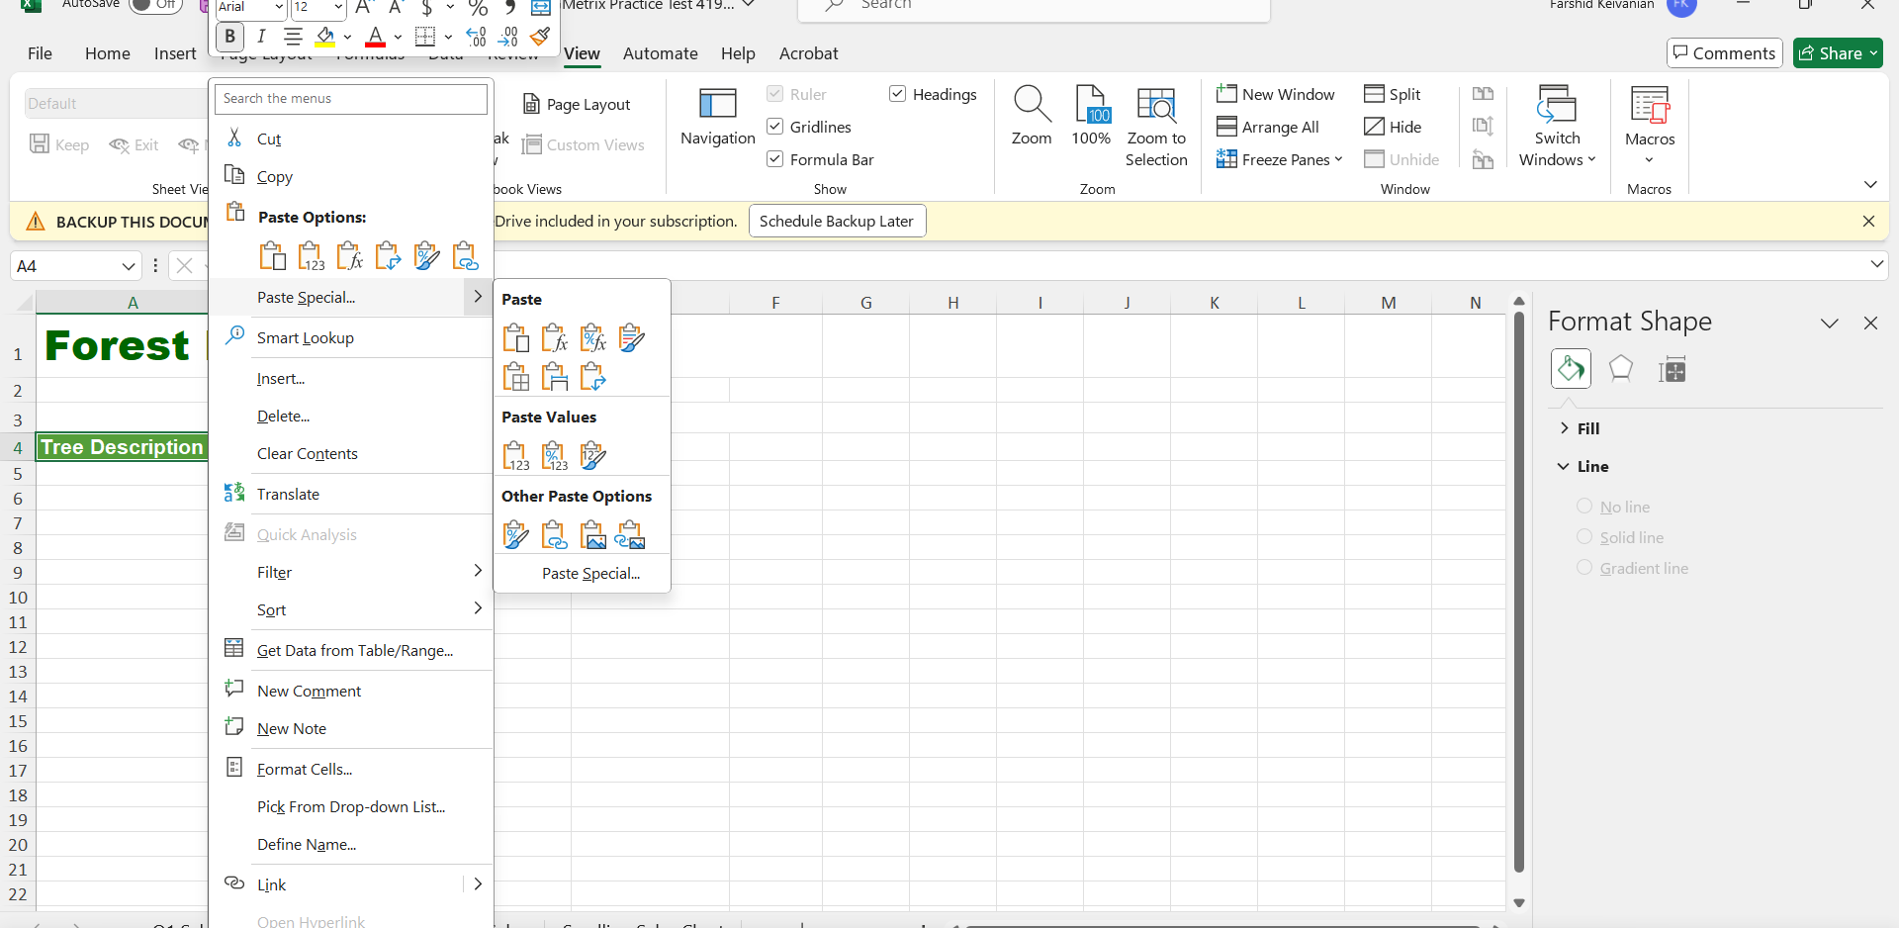
Copy the data from cell range A4:E9 on the Q1 Sales worksheet and transpose it to the cell range beginning at A4 on the Seedling Sales worksheet.
Paste Special >> Transpose

Slide 34
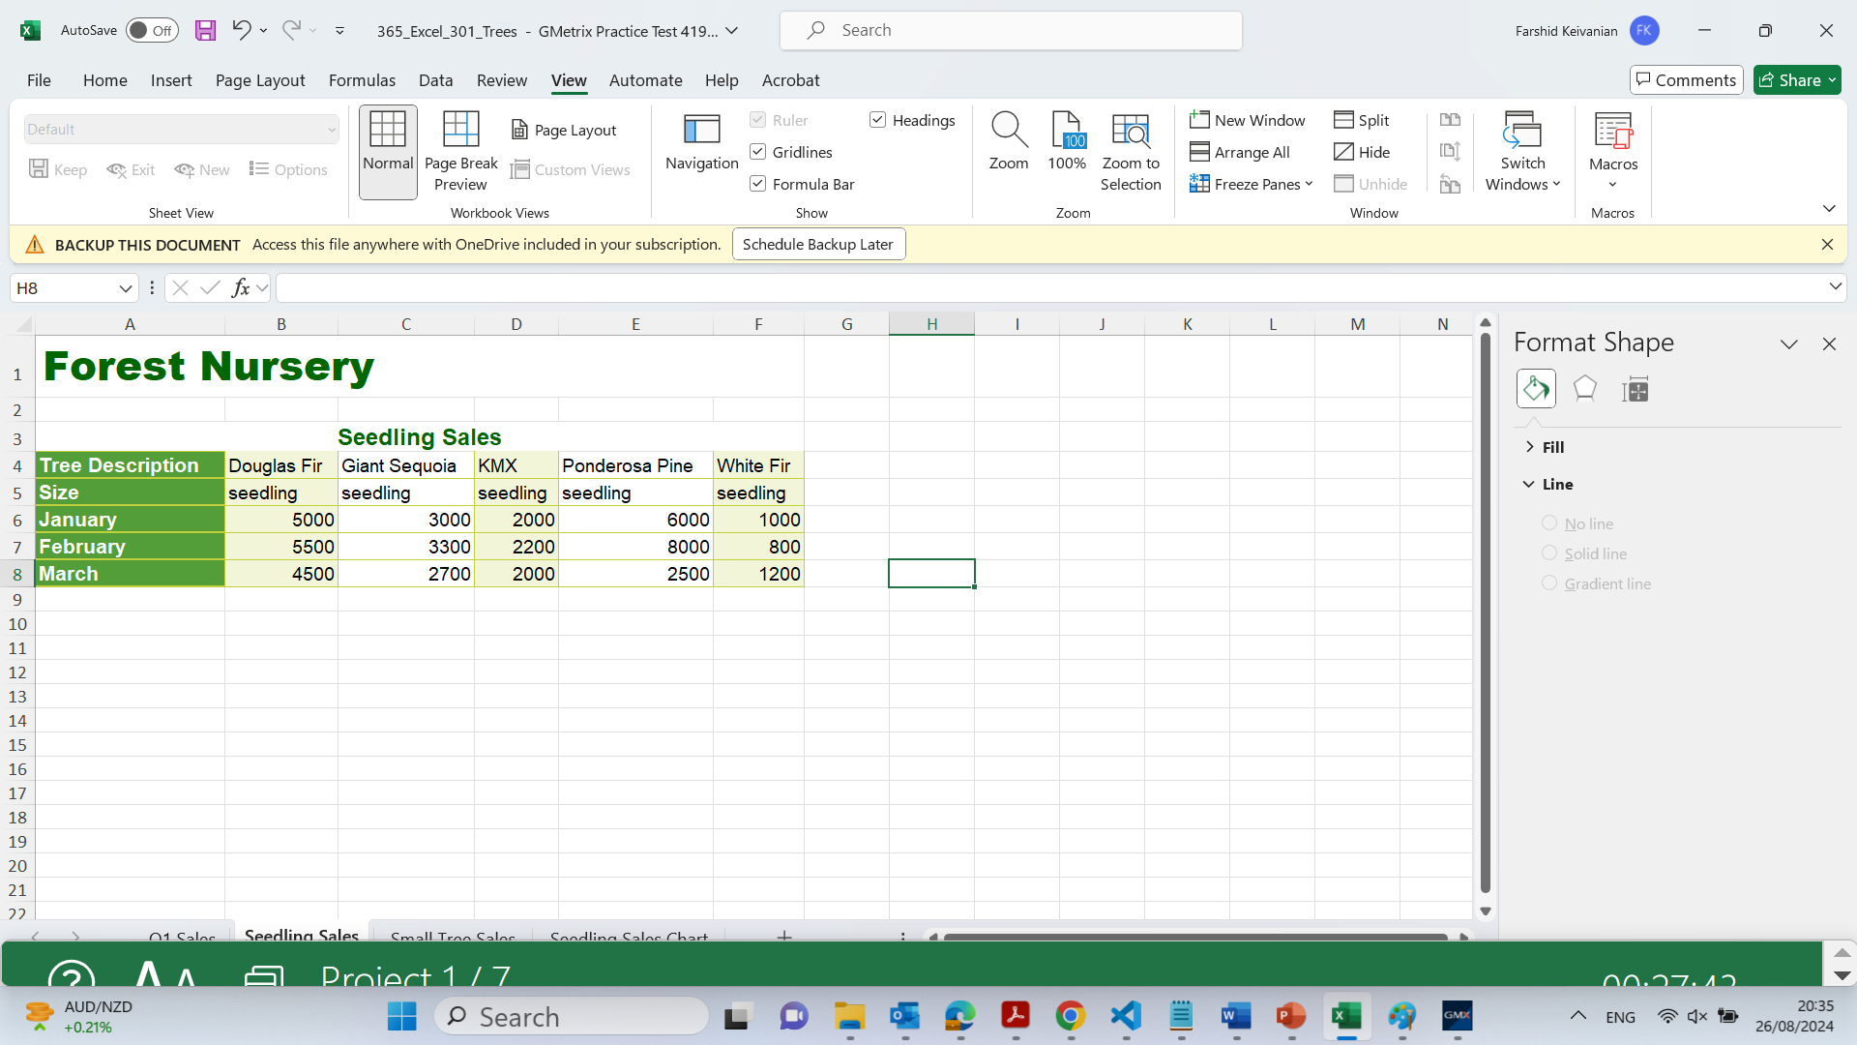
Copy the data from cell range A4:E9 on the Q1 Sales worksheet and transpose it to the cell range beginning at A4 on the Seedling Sales worksheet.
This will paste the data from the Q1 Sales worksheet into the Seedling Sales worksheet with rows and columns swapped.

Slide 35
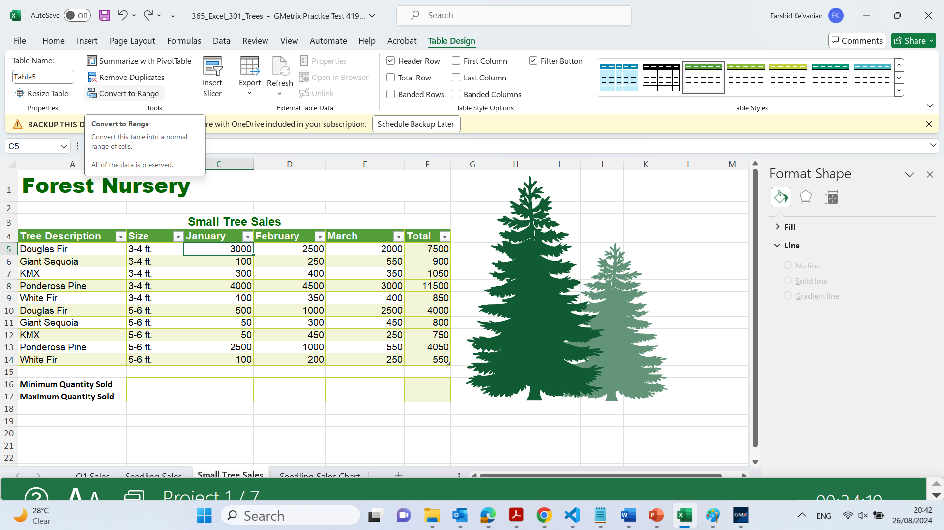
Remove the table formatting from the Small Tree Sales worksheet, but keep the cell formatting.

Slide 36
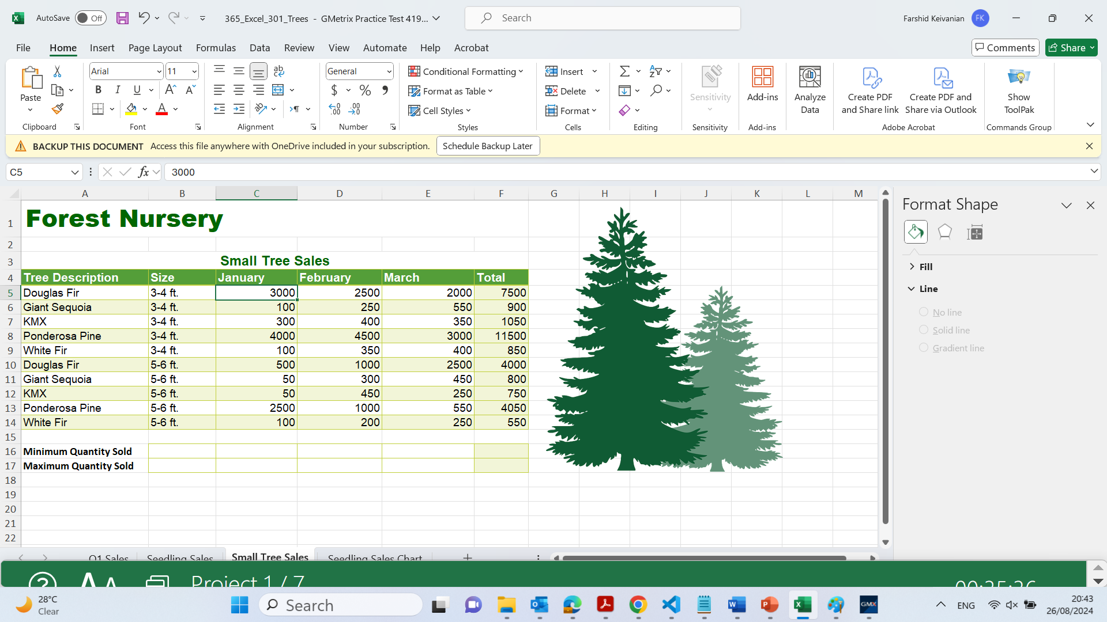
Remove the table formatting from the Small Tree Sales worksheet, but keep the cell formatting.

